Slide 1
Project Pitch: Identity and profile management API
Final Project
Student No: 230668566

Slide 2
Agenda of Project Pitch
Today I would be touching on the following items:
I would be discussing the template used in my project.
I would be also discussing my motivation of the project that I would be doing.
I would also provide 2 similar projects and evaluate them and share what is done by the projects and what is currently lacking in them that I wish to address using my project.
Possible Technologies that would be used in my Project.

Slide 3

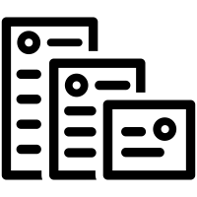
1
Template Used & Motivations for Project

Slide 4
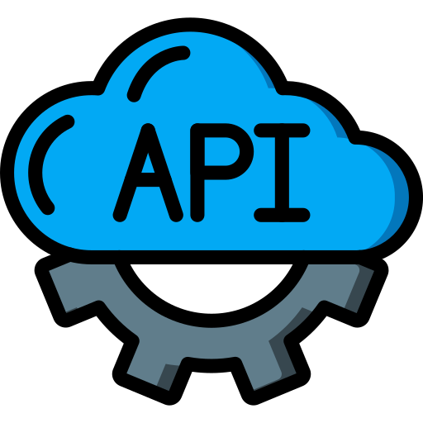
I have chosen–
Template 7.1
Advanced Web Design Project Idea 1: Identity and profile management API.

Slide 5
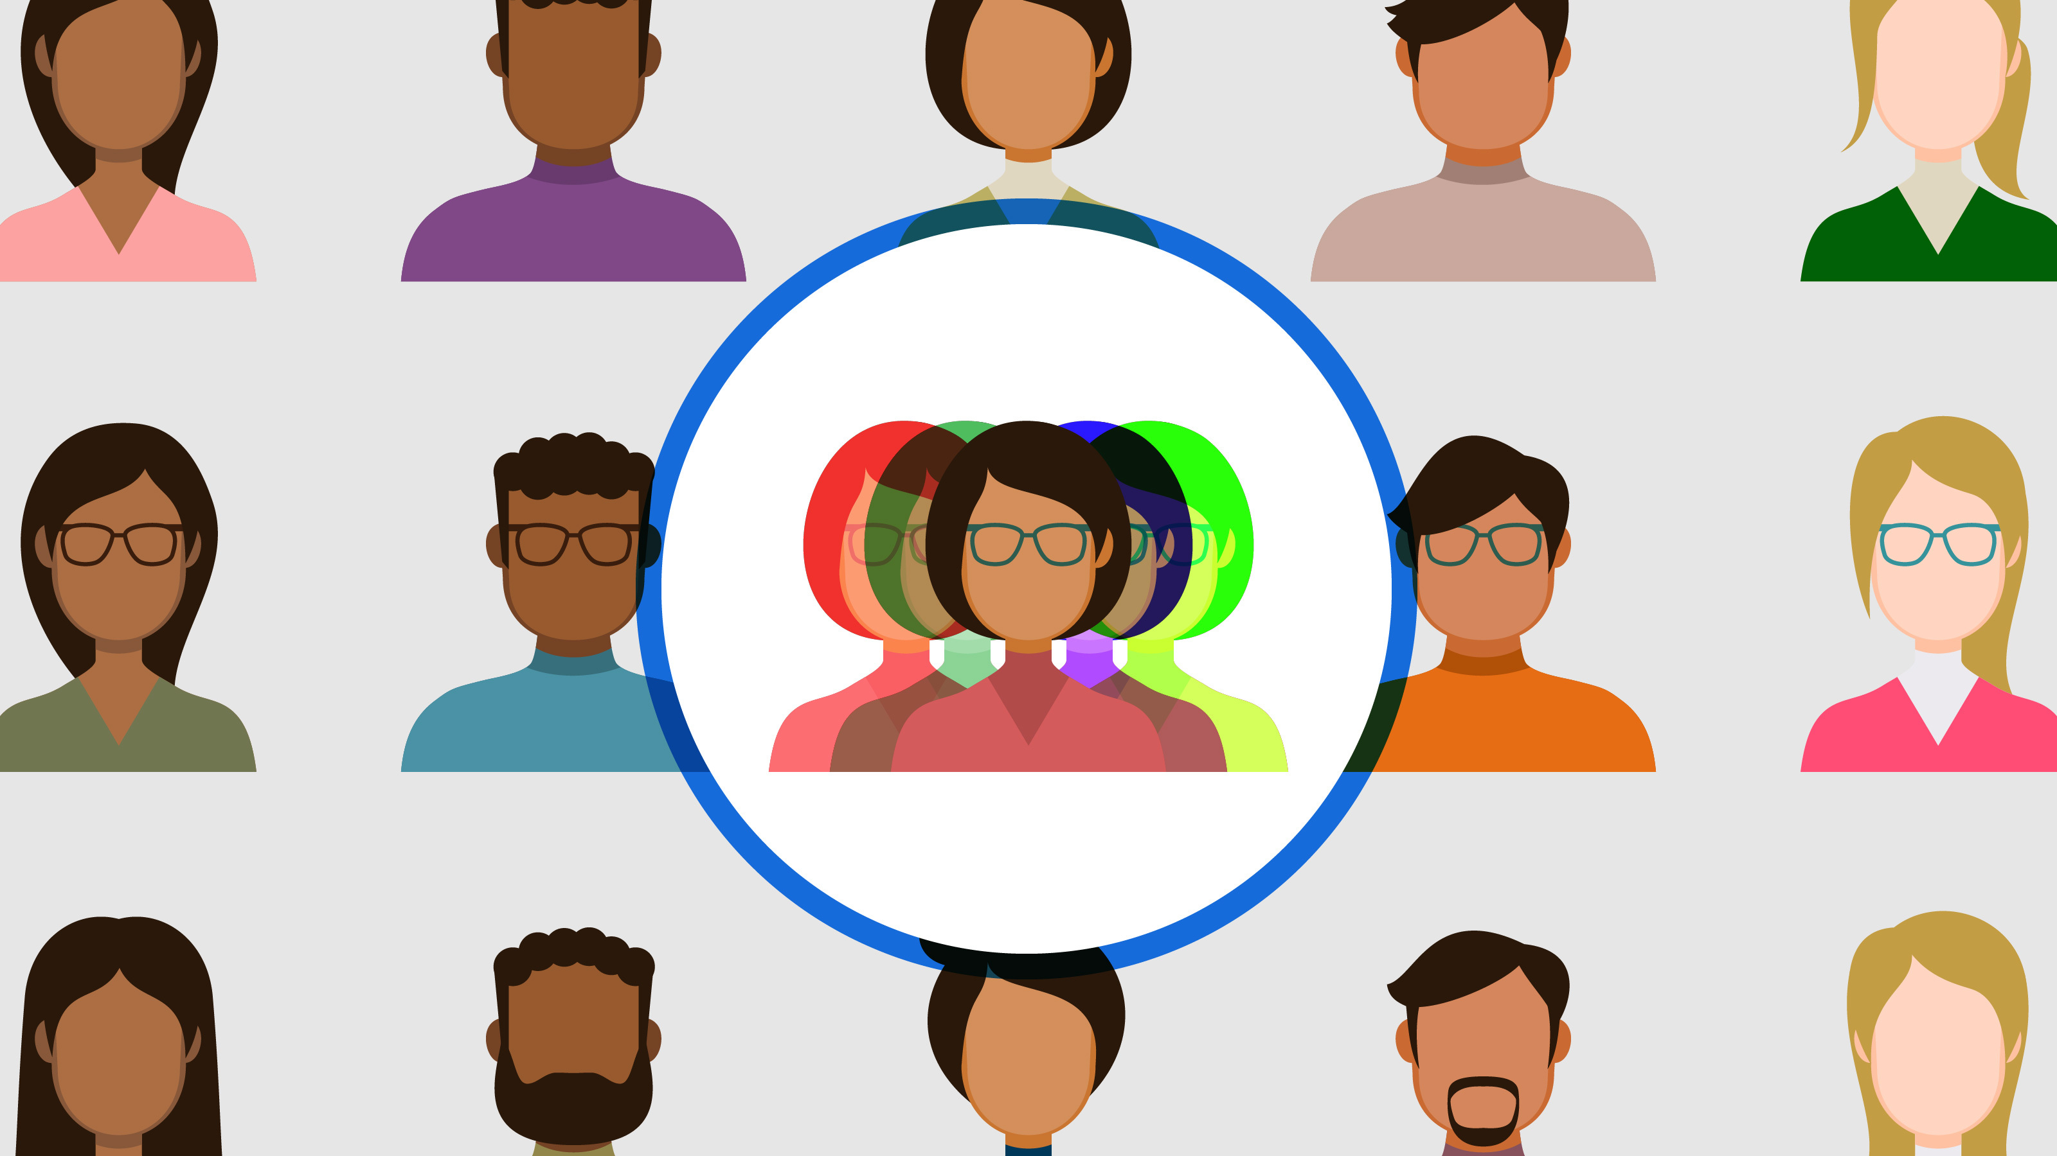
Project Idea
Motivation of the Project
In today’s hyperconnected world, constantly shifting between identities can be exhausting, disorienting, and even damaging to one’s well-being. Despite this complexity, most digital platforms still operate on a one-size-fits-all model — asking users to present a single, unified identity.
This oversimplification fails to reflect the fluid, multifaceted nature of who people truly are. As mentioned in the research done by Arfini et al. (2021), individuals naturally adapt different self-images to navigate the expectations and judgments of diverse social spheres.
However, this is hard in online spaces for three reasons:
Surveillance and Social Norms
The fear of surveillance—whether from employers, authorities, or even relatives—leads to self-censorship and difficulty expressing alternate identities (e.g., gender, religion, or political views). This is worsened by unethical data practices and lack of legislation, which can cause personal data to be leaked or misconstrued (McKoy et al., 2024). Thus, it's crucial to share only appropriate and context-specific information to protect one’s identity.

Slide 6

Project Idea (Continued)
Motivation of the Project
Cultural Expectations and Role Conflict
Asian collectivist cultures emphasize filial piety, conformity, and achievement, which can clash with younger individuals' need for self-expression and exploration.
In collectivist societies like Singapore, young adults are often caught between traditional expectations (filial piety, modesty, academic/professional success) and globalized ideals of self-expression, authenticity, and individualism. This push-and-pull between "who I should be" vs. "who I want to be" creates significant friction in identity management online. The result is emotional dissonance, hyper-curation of self-image, and even the use of multiple digital personas.
A 2022 study by a local news outlet, Lianhe Zaobao, and the Institute of Policy Studies found that 59% of Singaporean Gen Zs feel they cannot fully express their true selves on mainstream platforms.
This fragmentation not only makes managing multiple identities online cumbersome, but it also exacerbates the anxiety and stress that comes with navigating diverse, sometimes conflicting, social expectations. The constant need to curate, filter, and censor aspects of themselves online is a significant barrier, further complicating the management of their digital personas and leading to identity fatigue.

Slide 7
Project Idea (Continued)
Motivation of the Project
Cultural Expectations and Role Conflict
In collectivist cultures like Singapore, youth are caught between traditional values (e.g., filial piety, academic success) and globalized ideals of self-expression and individuality. This creates a constant push-and-pull between "who I should be" and "who I want to be.“
As a result, Singaporean youth often face role conflict, managing multiple online personas—one for family and professionals, another for personal or alternative expressions. A 2022 study by Lianhe Zaobao and the Institute of Policy Studies found that 59% of Singaporean Gen Zs feel they can't fully express their true selves online.
This identity fragmentation leads to emotional dissonance and anxiety, making it difficult to navigate the digital world and manage multiple identities effectively.

Slide 8

Project Idea (Continued)
Motivation of the Project
Lack of tool to manage multiple Identities
In today’s digital age, individuals—particularly young adults—are often forced to navigate multiple digital personas. Each persona may serve a different function, from professional representations on LinkedIn to personal expressions on Instagram, or even anonymous, experimental identities on platforms like Reddit or TikTok. However, there is no central tool or system to effectively manage these fragmented identities.
People need to adapt to the unique expectations of each platform. For instance, LinkedIn demands a polished professional image, while Instagram may allow more casual or creative self-expression. But these platforms don't synchronize with one another. As a result, individuals must manually manage separate accounts, leading to confusion, time management issues, and even risk of identity overlap (e.g., personal posts becoming accessible to professional networks).

Slide 9


Hence, we come this point: How can we create a flexible, secure and user-friendly identity and online profile management system for young adults?

Slide 10

Project Idea (Continued)
Aim: To develop a secure, context-aware, persona-based identity and profile management API for young adults to manage different online identities.
Objectives:
Develop a system that intelligently adapts to different situations by providing users with the appropriate version of their identity based on context. This ensures that the user's identity is accurately represented according to the specific environment or requirement;
Evaluation of current tools and methods that users employ to manage profiles and difficulties experienced when using such tools;
Design an API architecture that can easily accommodate additional identity attributes—such as pronouns, titles—allowing for future enhancements while maintaining a focus on flexibility and adaptability to future needs.

Slide 11
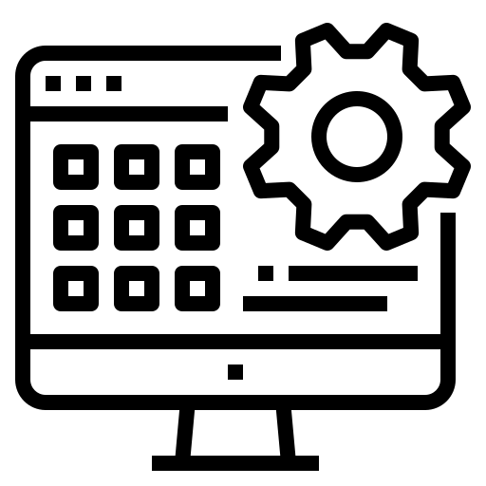
2
Similar applications or systems

Slide 12

Similar applications or systems
Traditional Solution: Writing Down the Information
Writing down passwords to online accounts in both physical and digital form.
Weakness:
Shoulder surfing attacks when logging into sites (Gerber et. al., 2023)
Changes to one profile (eg. phone) does not propagate to others.
May lead to leaking information to others inner threat agents (such as co-workers, or rivals)
Google: John@gmail.com pw: oA29NiNv123a

Slide 13
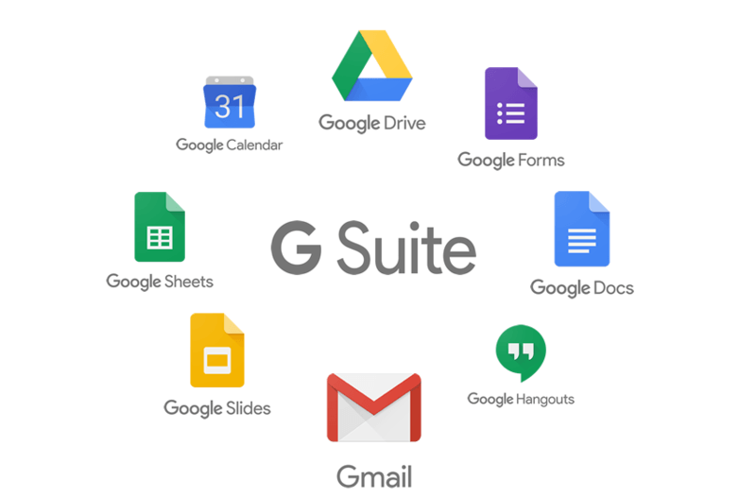
Similar applications or systems
Google's G Suite (formerly Google Apps for Work)
Discord Server Profiles
Discord’s Server Profiles feature allows users to customize their display name, profile picture, and pronouns for each server they are part of. This supports identity flexibility by enabling individuals to present themselves differently across various communities, such as gaming, work, or hobby groups.
Weakness
However, a key weakness of this function is its limited control over deeper identity attributes—users can only adjust a few surface-level elements. Elements such as Bio, Banner Images cannot be customized based on servers.
Google offers users the ability to have multiple email aliases (e.g., firstname.lastname@example.com, firstname@example.com) within the same account.
Weaknesses
While this offers flexibility in professional settings, it is still constrained to email addresses and lacks broader application in other areas such as profiles across apps or platforms.
Despite having multiple email aliases, everything routes to a single account with shared settings, contacts, and data. There's no true separation between your professional and personal contexts.

Slide 14

Similar applications or systems
Facebook’s Preferred Name and Pronouns Feature
Social platforms like Facebook have made strides in allowing users to input preferred names and pronouns. However, these features are often limited in scope and fail to address context. For example, Facebook allows users to display a "nickname" or "alternative name," but the user is still forced to maintain a primary, formal identity.
Weaknesses
The flexibility is minimal, and these features often don't extend across the entire platform experience, leaving certain sections (like messaging or professional interactions) still tied to the legal name. This limitation is significant, especially for marginalized groups like transgender or non-binary individuals, who might require a different name or pronoun depending on the context.

Slide 15
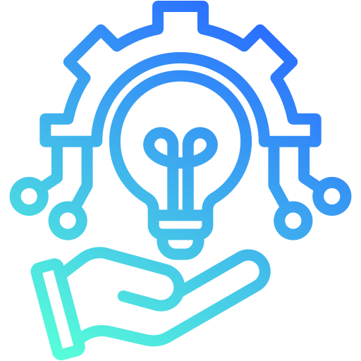
3
Possible Technologies Used

Slide 16


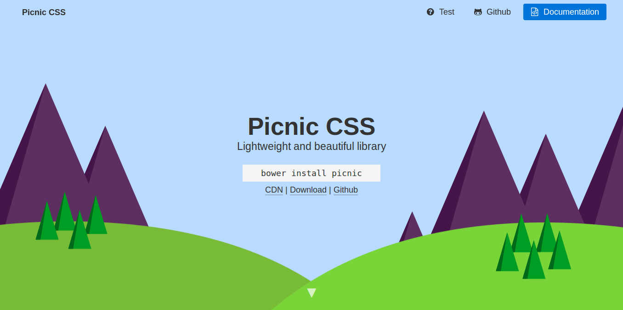
Possible Technologies to implement
In my Project, I would like to use the following Technologies:
Mainly would use the Django and its related RESTful API Framework, Django REST for the main API Implementation.
As for the Front-End Application, CSS Libraries such as Picnic CSS and Bootstrap!
Front-end Framework such as Vue.js or plain Vanilla HTML framework.

Slide 17
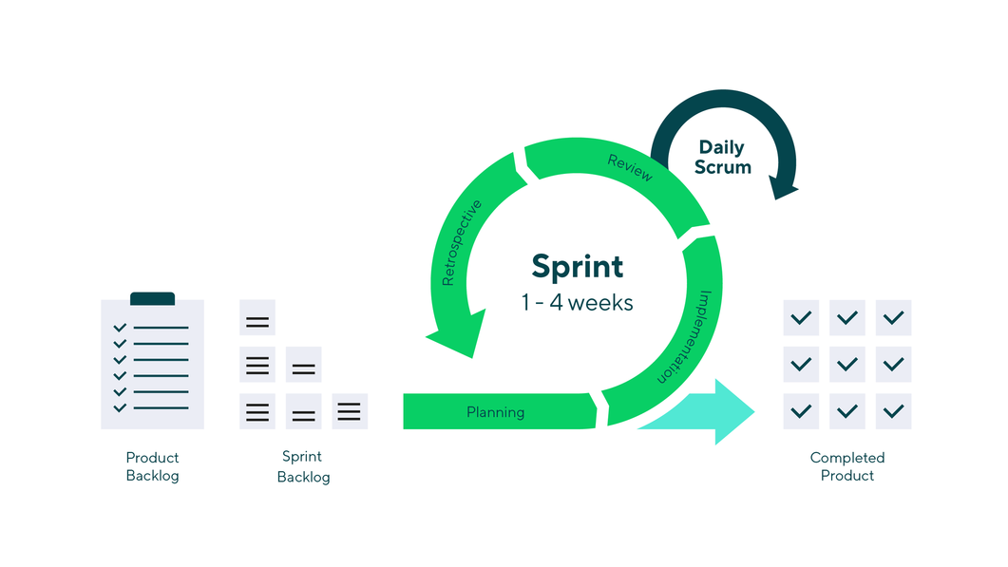
4
Possible Methodologies Used

Slide 18
Possible Methodologies Used
SDLC + Agile

Slide 19
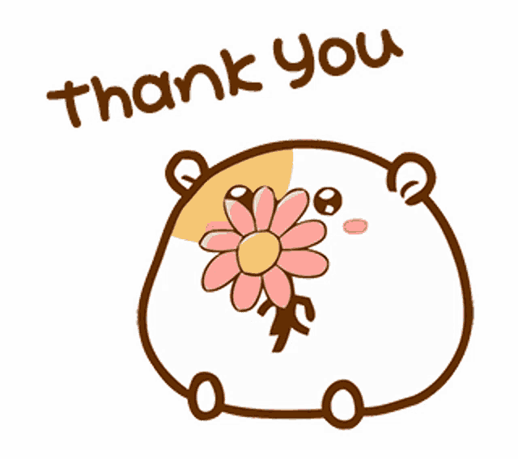
THANK YOU!

